Slide 1
Final Project
By Raymond Ynoa for CEN-4802C

Slide 2
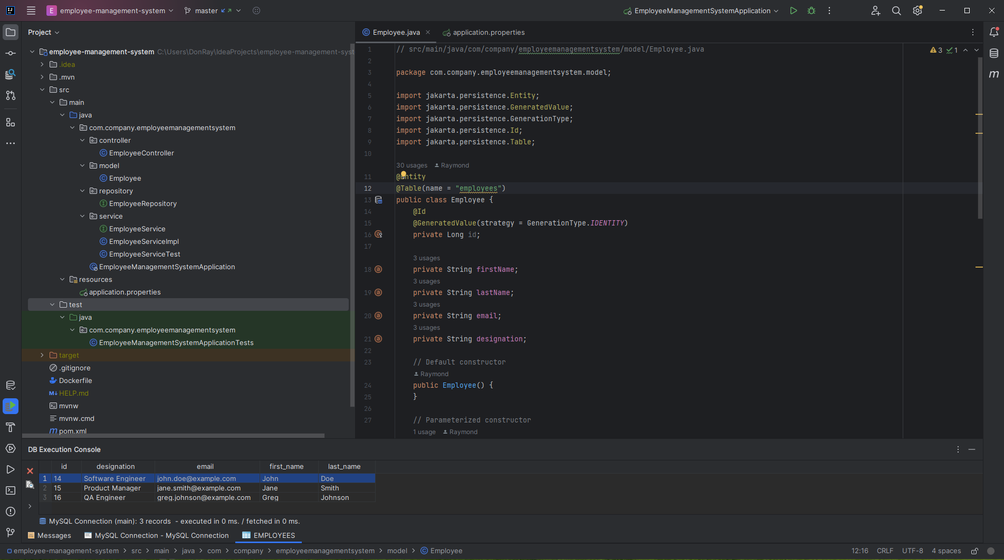
Code Example

Slide 3
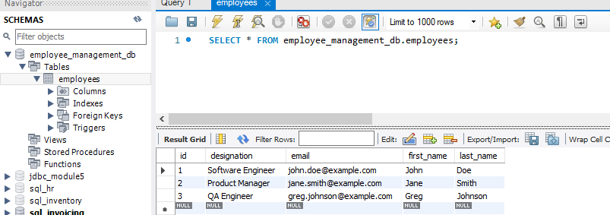
SQL Workbench

Slide 4
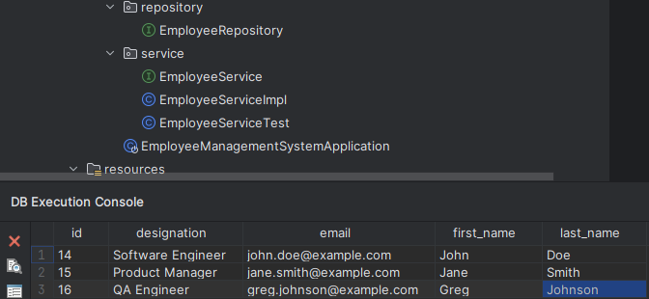
Connection to MySQL

Slide 5
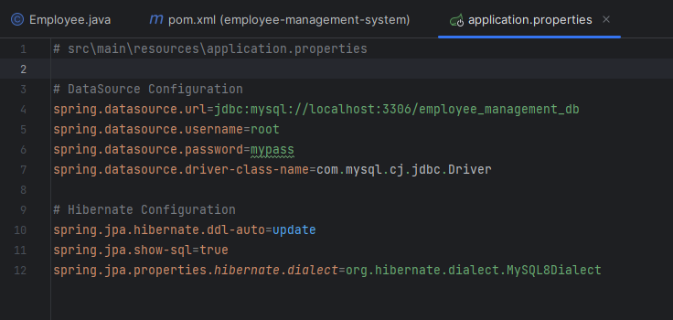
Spring Boot

Slide 6
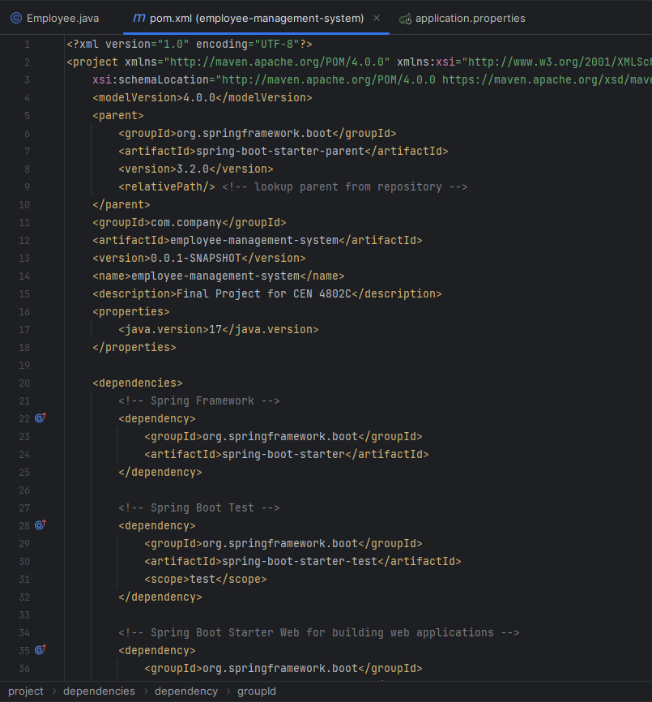
Maven Dependencies

Slide 7
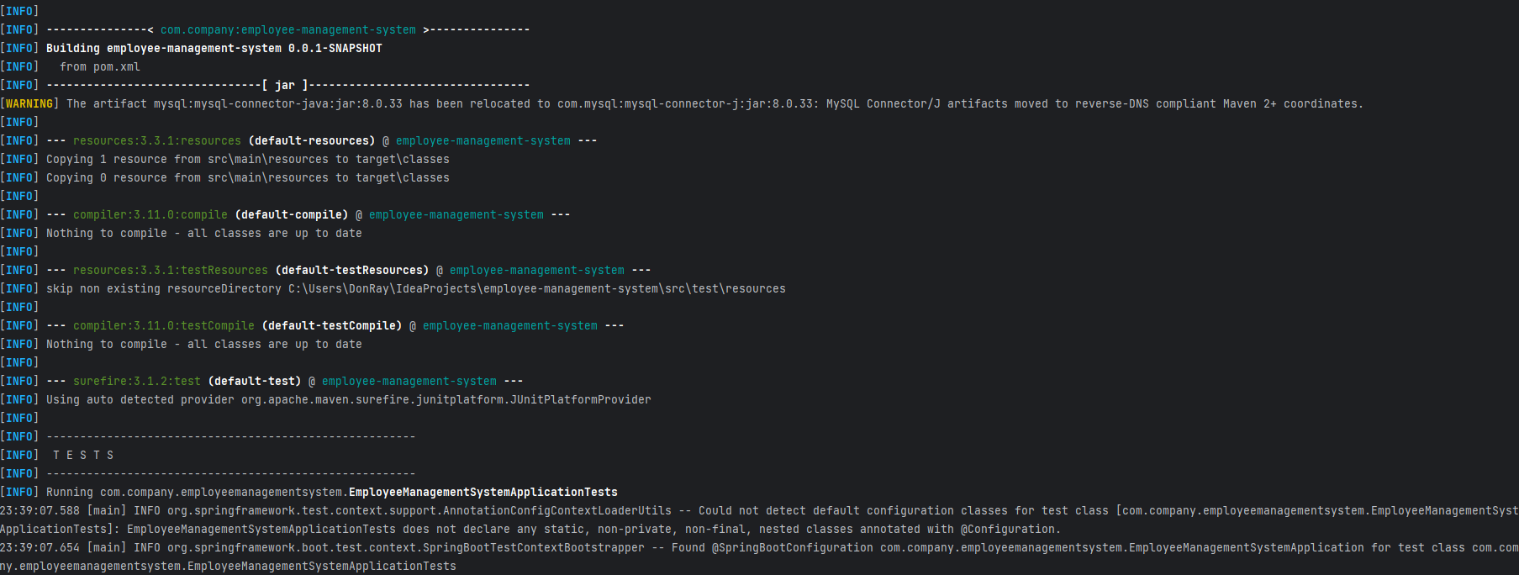
JUnit Testing

Slide 8
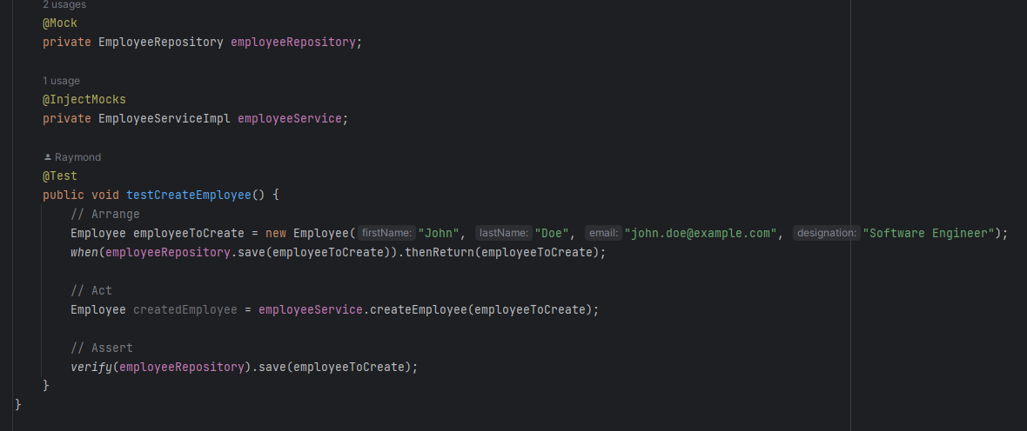
JUnit Test Example

Slide 9
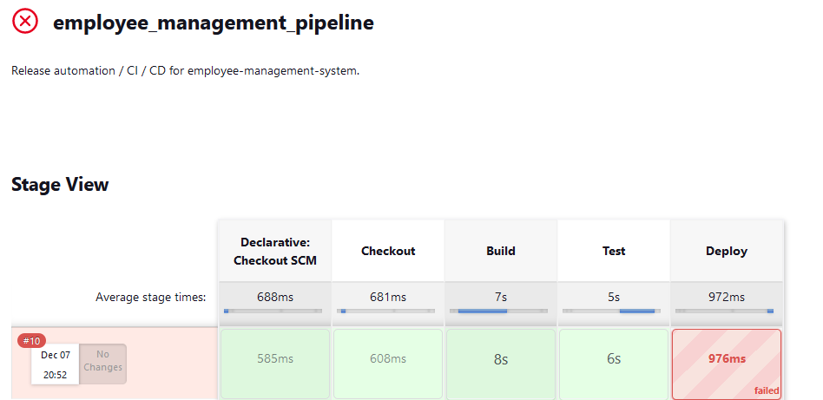
Jenkins Pipeline

